Slide 1

TEXT SUMMARIZATION USING DIFFERENT MODELS
Fall 2022 ADVANCED MACHINE LEARNING (MIS-64061-003)
- RIBA KHAN

Slide 2
GOAL
Use five different models for text summarization
Implement the best model on a new dataset( larger dataset) for summarizing

Slide 3
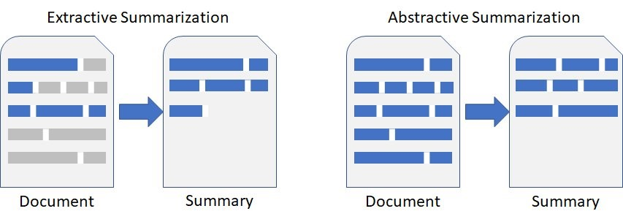
Summarization is the ability to explain a larger piece of literature in short and covering most of the meaning the context addresses.
ABSTRACTIVE SUMMARIZATION
In contrast, Abstractive Summarization uses heuristic techniques to teach the system to try and comprehend the entire context before producing a summary based on that understanding.
EXTRACTIVE SUMMARIZATION
In essence, extractive summarization means selecting a certain element (often sentences) based on specified weights assigned to the keywords, with the choice of text being determined by the weights of the words inside it.
Image taken from: https://aws.amazon.com/blogs/media/democratize-documentation-summarization-with-hugging-face-on-amazon-sagemaker/

Slide 4
The Text that I will be summarizing using Text Summarization models:
“Flames and a large plume of smoke could be seen in the Kent area Friday as crews worked to extinguish a massive re in the Historic Mill District. There broke out at Star of the West Milling Co. building at 162 N Water Street just before 9 a.m. Kent Fire Chief Bill Myers said that 3 minutes after firefighters arrived at the scene, there was an explosion. It’s not clear what caused it. The structure of the building was compromised after the explosion, so crews couldn’t go inside it. They worked on extinguishing the re from the outside, the re chief said. Chief Myers said they are also having some water supply issues. According to the chief, getting the re was taxing the water supply, so they were trying to reduce their use. The chief said re-operations could stretch into Saturday. No one was hurt in the re. It’s unclear how the building was currently being used. The chief said no evacuations were issued. Kent State University issued an alert saying there is no threat to the campus but to avoid the downtown area. The cause of the re is unknown. Named after the Williams Brothers in 1879, the Mill District of Kent, Ohio says the mill once produced hundreds of millions of pounds of ours. The iconic grain elevators are a well-known fixture in the city’s skyline. “
Source : Fox 8 News
Heading : Flames, explosions in Kent mill fire
By: Cris Belle, Dave Nethers
https://fox8.com/email-alerts/breaking-news-email-alerts/fire-breaks-out-at-in-kent-mill-district/

Slide 5
TEXT SUMMARIZATION MODELS
Luhn's Heuristic Method
Text Rank
Latent Semantic Analysis (LSA)
Kullback-Leibler Sum (KL-Sum)
T5 Transformer Model

Slide 6
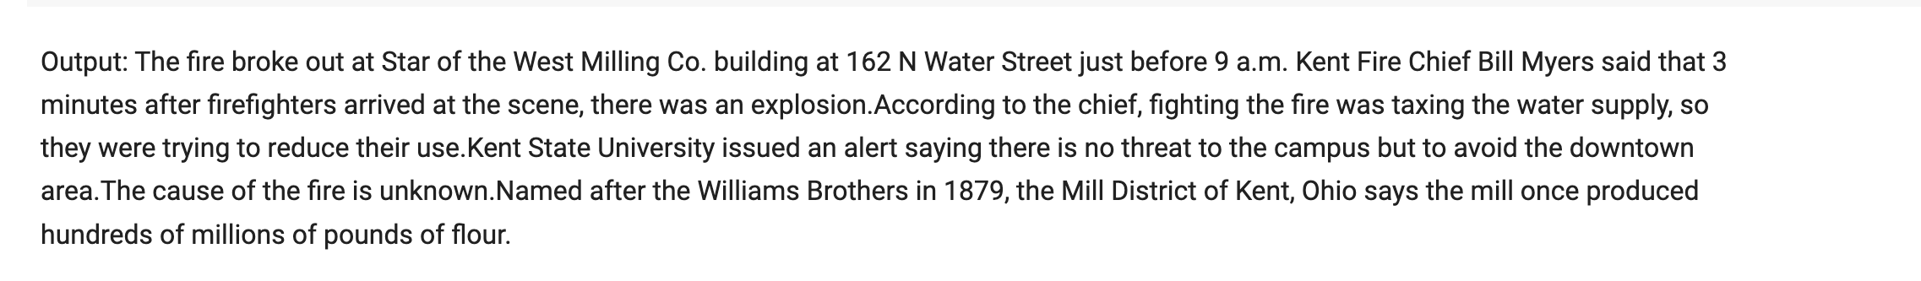
Luhn’s Heuristic Method
Luhn's Heuristic Method for Text Summarization is one of the first Text Summarization algorithms, being published in 1958. It is based on TF-IDF (Term Frequency-Inverse Document Frequency), and selects words of high importance based on their frequency of occurrence. Also, higher weightage is given to the words that occur at the beginning of the document.

Slide 7
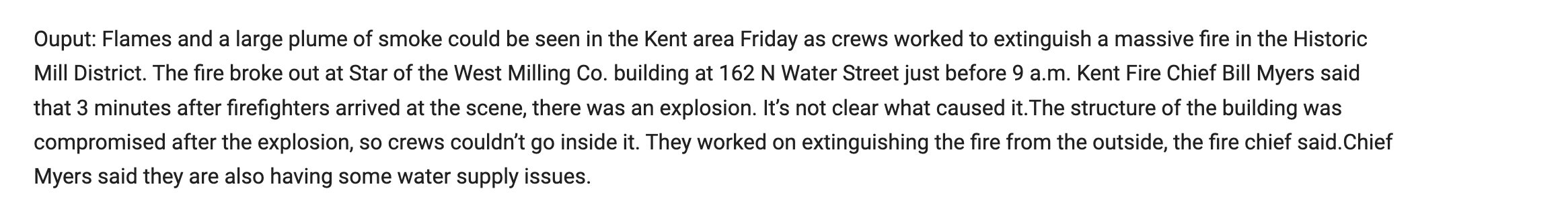
The Text that we will be summarizing using all of the aforementioned Text Summarization models:
Flames and a large plume of smoke could be seen in the Kent area Friday as crews worked to extinguish a massive re in the Historic Mill District. The re broke out at Star of the West Milling Co. building at 162 N Water Street just before 9 a.m. Kent Fire Chief Bill Myers said that 3 minutes after reghters arrived at the scene, there was an explosion. It’s not clear what caused it.The structure of the building was compromised after the explosion, so crews couldn’t go inside it. They worked on extinguishing the re from the outside, the re chief said.Chief Myers said they are also having some water supply issues. According to the chief, ghting the re was taxing the water supply, so they were trying to reduce their use. The chief said re operations could stretch into Saturday.No one was hurt in the re. It’s unclear how the building was currently being used. The chief said no evacuations were issued. Kent State University issued an alert saying there is no threat to the campus but to avoid the downtown area.The cause of the re is unknown.Named after the Williams Brothers in 1879, the Mill District of Kent, Ohio says the mill once produced hundreds of millions of pounds of our. The iconic grain elevators are a well-known xture in the city’s skyline.
2) Text Rank
It is used to find the most relevant sentences (as well as keywords) in a piece of text. Here, sentences that contain highly frequent words are considered important. Thus, the algorithm assigns scores to each sentence in the source material. The sentences are then ranked in descending order of their scores, and the top-scoring sentences are included in the summary.

Slide 8
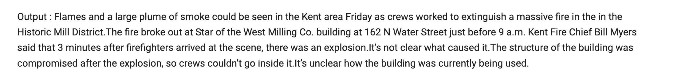
The Text that we will be summarizing using all of the aforementioned Text Summarization models:
Flames and a large plume of smoke could be seen in the Kent area Friday as crews worked to extinguish a massive re in the Historic Mill District. The re broke out at Star of the West Milling Co. building at 162 N Water Street just before 9 a.m. Kent Fire Chief Bill Myers said that 3 minutes after reghters arrived at the scene, there was an explosion. It’s not clear what caused it.The structure of the building was compromised after the explosion, so crews couldn’t go inside it. They worked on extinguishing the re from the outside, the re chief said.Chief Myers said they are also having some water supply issues. According to the chief, ghting the re was taxing the water supply, so they were trying to reduce their use. The chief said re operations could stretch into Saturday.No one was hurt in the re. It’s unclear how the building was currently being used. The chief said no evacuations were issued. Kent State University issued an alert saying there is no threat to the campus but to avoid the downtown area.The cause of the re is unknown.Named after the Williams Brothers in 1879, the Mill District of Kent, Ohio says the mill once produced hundreds of millions of pounds of our. The iconic grain elevators are a well-known xture in the city’s skyline.
3) Latent Semantic Analysis
It is an unsupervised Natural Language Processing (NLP) technique. The goal is to identify the most important topics from the source material and then choose the sentences with the greatest combined weights across the topics.

Slide 9
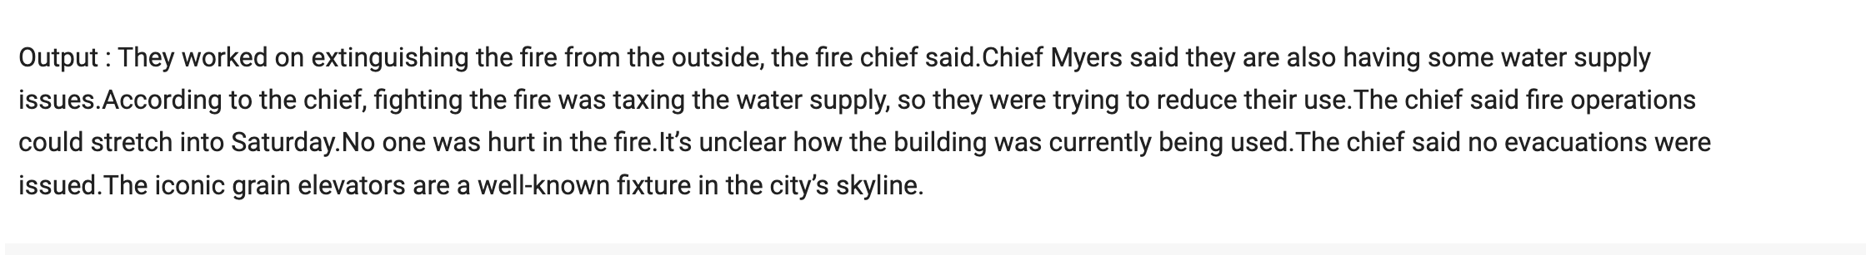
The Text that we will be summarizing using all of the aforementioned Text Summarization models:
Flames and a large plume of smoke could be seen in the Kent area Friday as crews worked to extinguish a massive re in the Historic Mill District. The re broke out at Star of the West Milling Co. building at 162 N Water Street just before 9 a.m. Kent Fire Chief Bill Myers said that 3 minutes after reghters arrived at the scene, there was an explosion. It’s not clear what caused it.The structure of the building was compromised after the explosion, so crews couldn’t go inside it. They worked on extinguishing the re from the outside, the re chief said.Chief Myers said they are also having some water supply issues. According to the chief, ghting the re was taxing the water supply, so they were trying to reduce their use. The chief said re operations could stretch into Saturday.No one was hurt in the re. It’s unclear how the building was currently being used. The chief said no evacuations were issued. Kent State University issued an alert saying there is no threat to the campus but to avoid the downtown area.The cause of the re is unknown.Named after the Williams Brothers in 1879, the Mill District of Kent, Ohio says the mill once produced hundreds of millions of pounds of our. The iconic grain elevators are a well-known xture in the city’s skyline.
4) Kullback-Leibler Sum (KL-Sum)
K-L sum algorithm (Kullback-Lieber (KL) Sum algorithm) for text summarization which focuses on minimization of summary vocabulary by checking the divergence from the input vocabulary.
It is a sentence selection algorithm where a target length for the summary is fixed (L words).
The objective of KL sum algorithm is to find a set of sentences whose length is less than L words and the unigram distribution is as similar to the source document

Slide 10
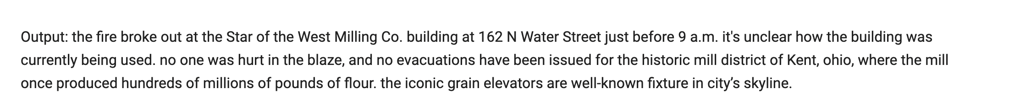
5) Transformers
Transformers are a type of neural network architecture and were developed by a group of researchers at Google (and UoT) in 2017. They avoid using the principle of recurrence and work entirely on an attention mechanism to draw global dependencies between the input and the output.

Slide 11
The match-rate of unigrams between the output of our model and the reference would be measured for ROUGE-1.
Bigrams and trigrams would be used for ROUGE-2 and ROUGE-3, respectively.
We now choose whether to compute the ROUGE recall, precision, or F1 score after deciding which N to utilize.
ROUGE METRICS
ROUGE, which stands for Recall-Oriented Understudy for Gisting Evaluation, is a metric that is used to obtain the degree of similarity between a candidate summary (automatically generated summary) and the target summary (hand-written reference summary.

Slide 12
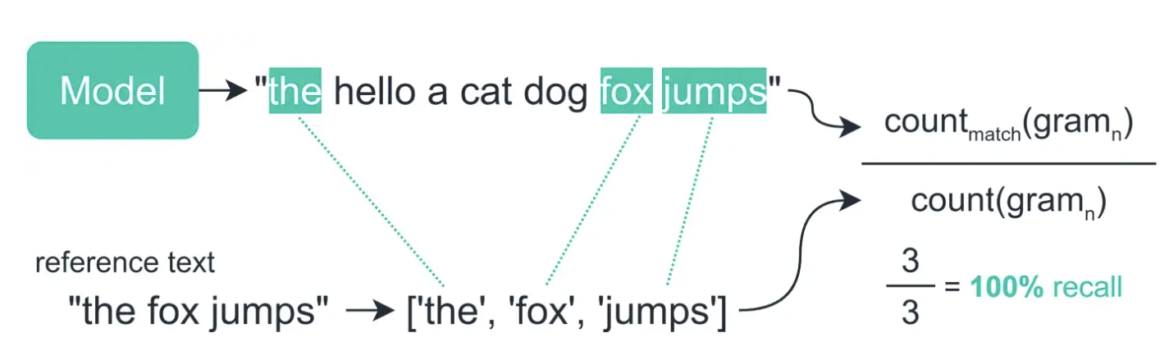
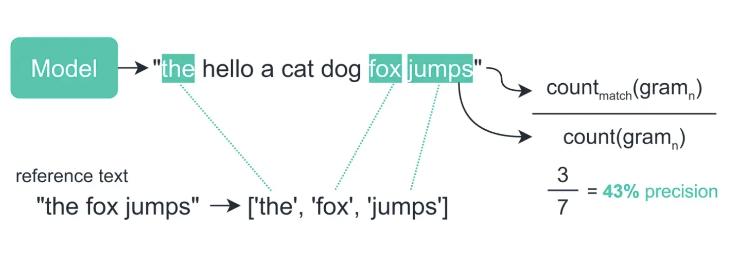
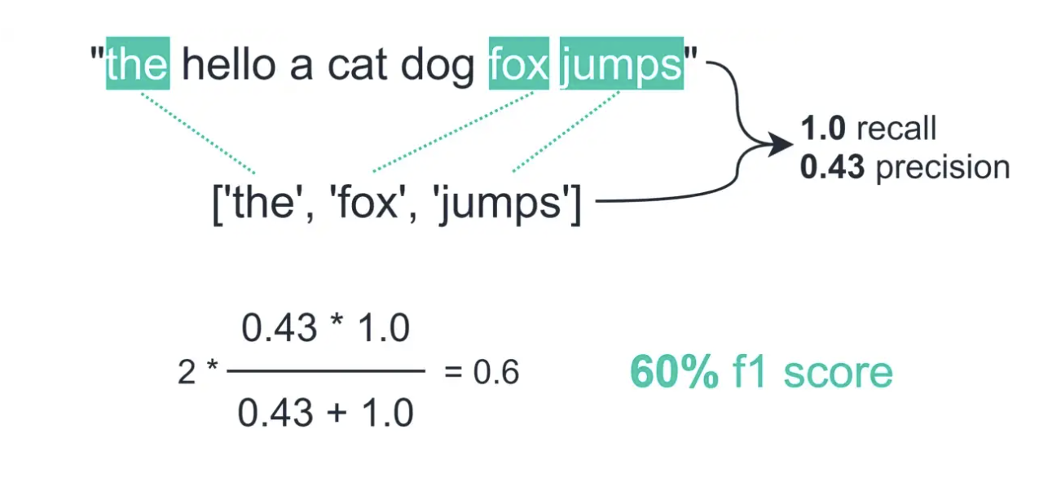
RECALL
The recall counts the number of overlapping n-grams found in both the model output and reference — then divides this number by the total number of n-grams in the reference.
PRECISION
The precision metric — which is calculated in almost the exact same way, but rather than dividing by the reference n-gram count, we divide by the model n-gram count
F1 SCORE
Then, ROUGE-1 F1-score can be directly obtained from the ROUGE-1 precision and recall using the standard F1-score formula. It is calculated by 2*(precision * recall)/(precsion + recall)

Slide 13
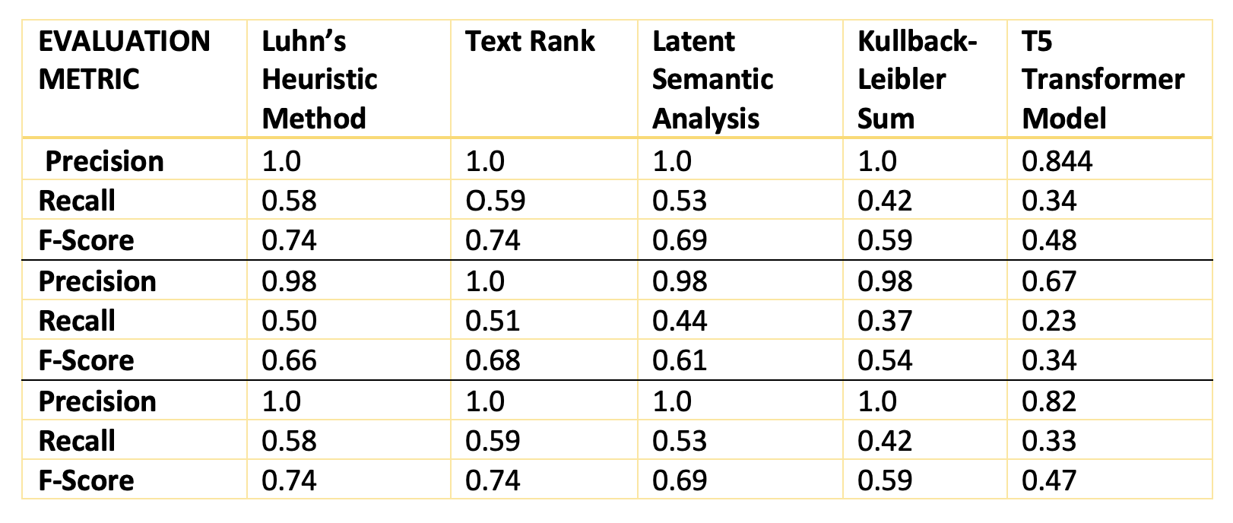
EVALUATION USING ROUGE METRICS
ROUGE 1
ROUGE scores are divided into ROUGE-1, ROUGE-2, and ROUGE-L scores.
ROUGE 2
ROUGE L

Slide 14
Findings and Conclusions:
Luhn’s Heuristic Method and Text rank scored very similarly and could have performed differently on different input documents.
In terms of readability, the Transformer model produced the best summary as it closely resembles the human-made summary.
The summary produced by Luhn’s Heuristic Method is not accurate enough because it is one of the earliest Text summarization models to come into the picture.
While a lot of work is still being done in the field of Abstractive Summarization, it is impressive to see how well the trained model summarized our source material. Our source material might have provided a summary with a higher ROUGE score than the other Extractive Models that we reviewed above if it contained more sentences.

Slide 15
Applying Transformers to Real World data
I utilized the Inshorts dataset for this challenge. A service called Inshorts gathers news from multiple sources and distributes it as an overview (or "in short").

Slide 16
1
Pre-Processing
Tokenization API
2
Utility Functions
Postal Encodings
Padding
Multi Head Attention
3
Building the Model
Encoder and Decoder Blocks
4
Training the Model
Define hyperparameters
5
Inference
Implement and Results

Slide 17
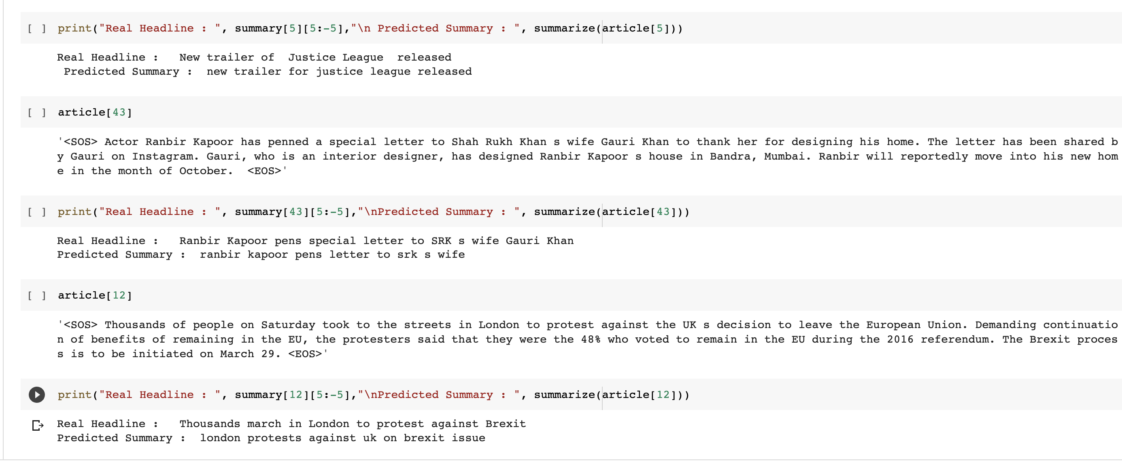
Results

Slide 18
Contributions:
Able to successfully study five different text summarization models
Implemented transformers for text summarization on real-world data
Learned a new way – Rouge Metrics to study the accuracy of text summarization models

